Slide 1
Input Analysis

Slide 2
Input Analysis
Initial steps of the simulation study have been completed.
Through a verbal description and/or flow chart of the system operation to be simulated, the random components of the system have been identified.
The needed data has been identified and collected.
For random components input analysis will cover how to specify what distributions should be used in the simulation model.

Slide 3
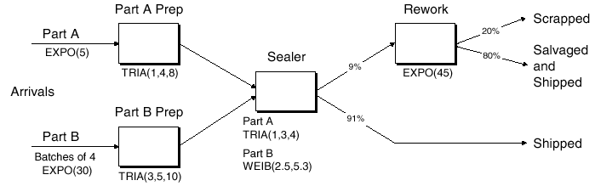
Example

Slide 4
Identifying Random System Components
Examples
The amount of variability/randomness is relative to the system.
E.g., Machine processing time – not fixed but low variability.

Slide 5
Identifying Random System Components
The concept of relative variability for a random variable X, as measured by the coefficient of variation (CV(X)) may help.

Slide 6
Identifying Random System Components
Consider the single server model with a utilization =0.983.
Both the service times and interarrival times have a CV=1.
The average number in queue = 57 jobs.
If the service time CV=0
If the service time CV = 0.25

Slide 7
Identifying Random System Components

Slide 8
Identifying Random System Components
If the system contains many different random components, and data collection resources are limited focus on random components with higher CVs.

Slide 9
Collecting Data
Collect data that corresponds to what will be simulated.
More is better.
Examples
Customer/job arrivals.
Collect the number of customer arrivals or
collect customer interarrival times?
Job processing times.
What does the time between jobs include?

Slide 10
Collecting Data
Through observation of the system
From historical data
Must be cautious about using data from databases without a complete understanding of what is included in the data
Will often require additional processing

Slide 11
Collecting Data Through Observation - Example
Simulation of vehicle traffic at an intersection.
Arrivals of cars to the intersection – what will you collect?

Slide 12
Collecting Data Through Observation - Planning
Create your data collection scenario
Consider
What data will be recorded
Once data is collected

Slide 13
Input Analysis
Assume you have “raw” data collected for some random component of the system.
Example: Service time data (minutes)

Slide 14
Input Analysis
The random component of the system will be represented in the simulation model as observations from a probability distribution.

Slide 15
Input Analysis
This process is called “fitting a distribution”.
Fitting a distribution - Selecting and justifying the proper distribution to use in the simulation to represent the random system component.
In general there are two choices for the type of distribution fitted.

Slide 16
Input Analysis
When to use empirical distributions.

Slide 17
Input Analysis
Empirical distributions
Generates observations that match the percentage of different observations in the collected data.
Example – Discrete case

Slide 18
Input Analysis
Good features of empirical distributions.
Simulated distribution represents actual data collected over a specific period of time, which is good for validation purposes, if performance measures for the same period of time are known.
Bad features of empirical distributions.
The data collected only reflects observations over the time period in which it was collected, and may not accurately represent what could occur.

Slide 19
Input Analysis
Arena
Discrete empirical distribution
DISC(0.25, 1, 0.5, 1.25, 0.8, 1.75, 1.0, 2)

Slide 20
Input Analysis
Arena
Continuous empirical distribution
CONT(0.25, 1, 0.5, 1.25, 0.8, 1.75, 1.0, 2)

Slide 21
Fitting Theoretical Distributions
General procedure
Guess/hypothesize an appropriate theoretical distribution with specific parameters.
Apply a statistical test to the hypothesis that the observed data are observations from the theoretical distribution from step 1.
Repeat if necessary.
Software available to quickly perform fitting.

Slide 22
Fitting Theoretical Distributions
Step 1 – Suggesting a distribution.
Use process knowledge/theory.
Descriptive statistics.
Histograms.
Process knowledge/Theory
Inspections, large population, inspection sample size =n.
Parts processed between failures.

Slide 23
Fitting Theoretical Distributions
Process knowledge/Theory
Customer arrivals to a system from a large population.
Normal distribution.

Slide 24
Fitting Theoretical Distributions
Descriptive statistics
Coefficient of variation (for X continuous) – CV(X)
Different theoretical distributions have different values or ranges of possible values.
X~Exponential : CV= 1.
X~U(a,b) :
X~Lognormal : 0 < CV < ∞.

Slide 25
Fitting Theoretical Distributions
Descriptive statistics
Lexis ratio (for X discrete = Var(X)/E(X)) denoted τ(X)
Different theoretical distributions have different values or ranges of possible values.
X~Geometric(p) : τ(X)= 1/p.
X~Binomial(n,p) : τ(X)= 1-p.
X~Poisson : τ(X)= 1.

Slide 26
Fitting Theoretical Distributions
When data has been collected, the CV or lexis ratio can be estimated from the data using the sample variance/standard deviation, and sample mean.

Slide 27
Fitting Theoretical Distributions
Skewness – A measure of symmetry.

Slide 28
Fitting Theoretical Distributions
Histograms – A graph of the frequency of observations within predefined, non-overlapping intervals.
It is an estimate of the shape of a random variables probability mass function or density function.
Density functions/probability mass functions tend to have recognizable shapes.

Slide 29
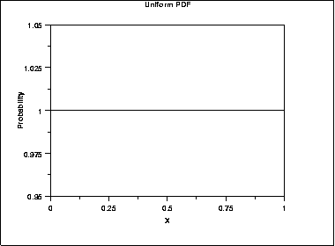
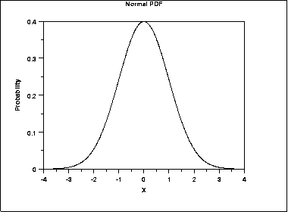
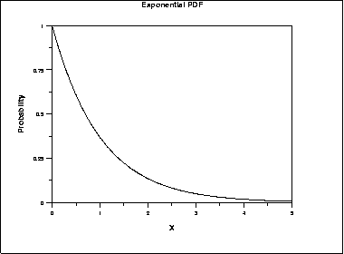
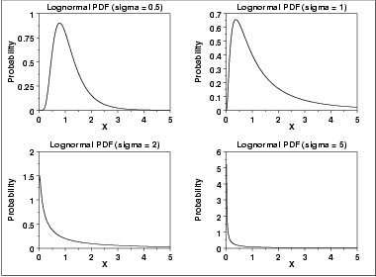
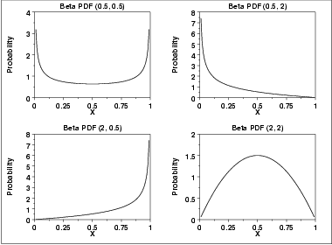
Fitting Theoretical Distributions

Slide 30
Fitting Theoretical Distributions
Making a histogram
Break up the range of values covered by the data into k disjoint intervals [b₀,b₁), [b₁,b₂),… ,[b_{k-1},b_{k}). All intervals should be the same width Δb except for the first and last intervals (if necessary).
For j = 1,2,…,k, let q_{j} = the proportion of the observations in the jth interval defined in 1.
Histogram value at x, h(x) = 0 if x < b₀, q_{j} if b_{j-1}≤x<b_{j}, and 0 if x ≥ b_{k}.

Slide 31
Fitting Theoretical Distributions
Making histograms
Histograms may be changed subjectively by changing the intervals and Δb (the interval size).
Guidelines (Hines, et al. 2003)
Keep the number of intervals between 5 and 20.
Set the number of intervals to be about the square root of the number of observations.

Slide 32
In-class Exercise
For data collected from different random components of a system.
Estimate the CV.
Construct a histogram.
Suggest a theoretical distribution to represent the random component.

Slide 33
In-class Exercise

Slide 34
In-class Exercise

Slide 35
Parameter Estimation
After suggesting a possible theoretical distribution to represent a random system component, the parameters for that distribution must be estimated from the data (x₁, x₂, …, x_{n}).
Different distributions may have a different number of parameters.
Estimating parameters from data for some distributions is intuitive.

Slide 36
Parameter Estimation
Attention will be restricted to maximum likelihood estimators or MLEs.
Good statistical properties (needed as part of a goodness of fit test).
Examples of MLEs
X~Exponential(λ)
λ = 1/E[X]
The MLE for λ is

Slide 37
Parameter Estimation
Examples of MLEs
X~Uniform(a,b)
X~Normal(μ,σ²)

Slide 38
Parameter Estimation
Not all MLEs for distribution parameters are so intuitive.
Example: X~Lognormal(σ,μ) where σ>0 is called a shape parameter and μ Є (-∞, ∞) is called a scale parameter.

Slide 39
Statistical Goodness of Fit Tests
A distribution has been suggested to represent a random component of a system.
The data has been use to compute estimates (MLE) of the distribution parameters.
Statistical goodness of fit tests determine whether there is enough evidence to say that the data is not well represented by the suggested distribution.

Slide 40
Statistical Goodness of Fit Tests
Let be the suggested distribution with parameters θ obtained from the data using MLE estimators.
The statistical goodness of fit tests will evaluate the null hypothesis

Slide 41
Statistical Goodness of Fit Tests
Three tests will be reviewed.
Chi-square goodness of fit test.
Kolmogorov-Smirnov test.
Anderson-Darling test.

Slide 42
Chi-square Goodness of Fit Test
Intuitively think of this test as a formal way to compare a modified histogram to a theoretical distribution.

Slide 43
Chi-square Goodness of Fit Test
Test procedure
Divide the entire range of the hypothesized distribution into k adjacent intervals – (a₀,a₁), [a₁,a₂),…,[a_{k-1},a_{k}) where a₀ could be -∞, and a_{k} could be + ∞.

Slide 44
Chi-square Goodness of Fit Test
Test procedure
Tabulate the number of observations falling in each interval – (a₀,a₁), [a₁,a₂),…,[a_{k-1},a_{k}). Let,
N_{j} = The number of observations falling in the jth interval [a_{j-1},a_{j}).
∑ N_{j} = n :the total number of observations.
Calculate the expected number of observations in each interval from the suggested distribution and estimated parameters.
Discrete
Continuous

Slide 45
Chi-square Goodness of Fit Test
Discrete

Slide 46
Chi-square Goodness of Fit Test
Continuous

Slide 47
Chi-square Goodness of Fit Test
Test procedure
Calculate the test statistic TS

Slide 48
Chi-square Goodness of Fit Test
If the distribution tested is a good fit, should TS be large or small?
How do we know what large or small is?
What do we compare TS to?
What is the sampling distribution of the test statistic.

Slide 49
Chi-square Goodness of Fit Test
Result – If MLE’s are used to estimate the m parameters of a suggested distribution, then if H₀ is true, as n→∞, the distribution of TS (the sampling distribution) converges to a Chi-square distribution that lies between two Chi-square distributions with k-1 and k-m-1 degrees of freedom.
If represents the value of the Chi-square distribution (df = degrees of freedom) such that of the area under the Chi-square distribution lies to the right of this value, then for the corresponding value for the distribution of TS

Slide 50
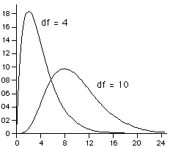
Chi-square Goodness of Fit Test
Density Function Plots for the Chi-Square Distribution

Slide 51
Chi-square Goodness of Fit Test
To be conservative, reject H₀ if
Needed values from the chi-square distribution can be found using the CHIINV function in Excel.

Slide 52
Chi-square Goodness of Fit Test
As with histograms, there are no precise answers for how to create intervals.

Slide 53
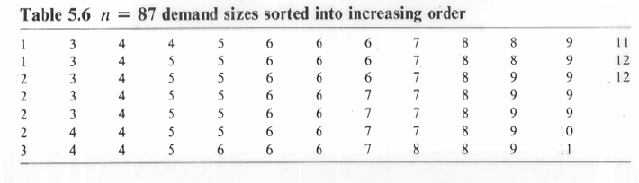
Example

Slide 54
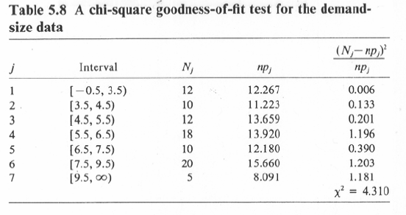
Example

Slide 55
In-class Exercise

Slide 56
In-class Exercise

Slide 57
In-class Exercise

Slide 58
Kolmogorov-Smirnov (K-S) Test
Pros
Does not require partitioning of the data into intervals.
When the parameters of a distribution are known, it is a more powerful test than the chi-square test (less probability of a type II error).

Slide 59
Kolmogorov-Smirnov (K-S) Test
Cons
Usually the parameters of a distribution are estimated.
Critical value (those values to compare to a test statistic) have been estimated for some hypothesized distributions using Monte Carlo simulation.
Normal
Exponential
Others (see Law and Kelton reference)
Difficult to use in the discrete case (ARENA Input Analyzer will generate no K-S test results).

Slide 60
Kolmogorov-Smirnov (K-S) Test
The parameters known case is used when the distribution parameters are estimated, and estimated critical values are not available.
This is conservative – The type I error is smaller than specified.

Slide 61
Kolmogorov-Smirnov (K-S) Test
The K-S test uses the empirical probability distribution function generated from the data as a basis for computing a test statistic.
Suppose there are n data observations collected, x₁,…,x_{n}.
The empirical distribution function F_{n}(x) is
This is a right continuous step function.

Slide 62
Example

Slide 63
Kolmogorov-Smirnov (K-S) Test
Intuitive description of the K-S test – Let be the distribution function of the suggested distribution. Overlay on F_{n}(x) and find the maximum absolute difference.
K-S test statistic D_{n:}

Slide 64
Kolmogorov-Smirnov (K-S) Test

Slide 65
Kolmogorov-Smirnov (K-S) Test
Test – Reject if

Slide 68
In-class Exercise
Conduct a K-S test to test the hypothesis that the data are observations from a U(0,10) distribution.

Slide 69
Anderson-Darling Test
Think of as a weighted K-S test.
More weight given to differences when the hypothesized probabilities are low – similar to percentage differences vs. absolute differences

Slide 70
Anderson-Darling Test
Critical values have been estimated for some hypothesized distributions

Slide 71
Goodness of Fit Tests
If a p-value is computed
Low p-values (< 0.05) indicate a poor fit.

Slide 72
Assessing Independence
It has been assumed that all observations of data for some random system component are independent.
The chi-square, K-S, and A-D tests are testing for independent identically distributed random variables.
Most discrete event simulation models and software assume random components are independent.

Slide 73
Assessing Independence
When presenting Monte Carlo simulation we talked about correlation.
Two or more random components of a simulation (e.g., engineering economic calculation) may be correlated.
E.g., Repair costs in year one and year two.
There was no simulated time component in these simulations.
In discrete event simulation correlation may occur,
Between different random components.
Within the same random component.

Slide 74
Assessing Independence
Examples
Different random components.
Within the same random component.

Slide 75
Recognizing Non-independence
Method 1 – Correlation estimates and hypothesis testing.
E.g., Rank correlation estimates.
Method 2 – Correlation plot.
Method 3 – Scatter diagram.

Slide 76
Recognizing Non-independence
Let x₁, x₂,…, x_{n} be collected data listed in the time order of collection.
Sample correlation
As j approaches n this estimate is very poor since the number of values used for the estimate is small.

Slide 77
Recognizing Non-independence
Scatter plot.
Plot of (x_{i}, x_{i+1}) or (x_{i},y_{i}).
Visual subjective interpretation.

Slide 78
Recognizing Non-independence
Correlation plot – Applicable when examining correlation within a single random component.
Plot C_{j} vs. j.

Slide 79
Example
Wait in queue. Correlated?
Single server system – Utilization = 0.98

Slide 80
Example – Correlation Estimates

Slide 81
Example – Scatter Diagram

Slide 82
Example Scatter Diagram – Zero Correlation

Slide 83
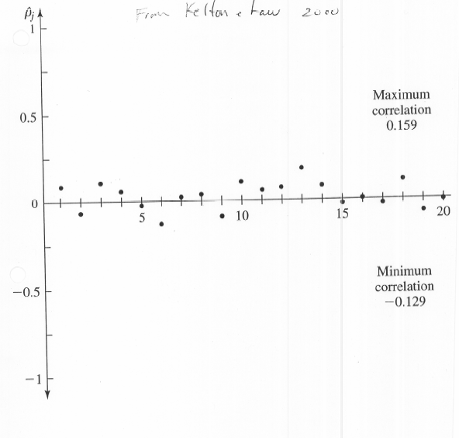

Slide 84
Recognizing Non-independence
If you determine that correlations exist, what do you do?

Slide 85
What to do with Minimal Information?
Suppose you cannot collect data or that none is available.
Suggested no data distributions.

Slide 86
What to do with Minimal Information?
Getting information about distribution parameters.

Slide 87
Non-stationary Arrival Processes
A very common feature of many systems (in particular service systems) is that the arrival rate (e.g., customers) varies as a function of time.
The arrival process is called non-stationary.

Slide 88
Non-stationary Arrival Processes
A practical method to approximate a non-stationary arrival process is to use a “piecewise constant” rate function.
Over predefined time intervals assume a constant (and different) arrival rate.

Slide 89
Non-stationary Arrival Processes
Example – A very common arrival process used in simulation is the Poisson process.

Slide 90
Non-stationary Arrival Processes
Implementation of a non-stationary Poisson process.
Common but incorrect approach.
Have the mean interarrival time (or interarrival rates) be represented with a variable. Change the value of this variable for each interval.

Slide 91
Non-stationary Arrival Processes
What’s wrong with this approach?

Slide 92
Non-stationary Arrival Processes
One correct approach for implementing a non-stationary Poisson Process is called thinning.

Slide 93
Non-stationary Arrival Processes

Slide 94
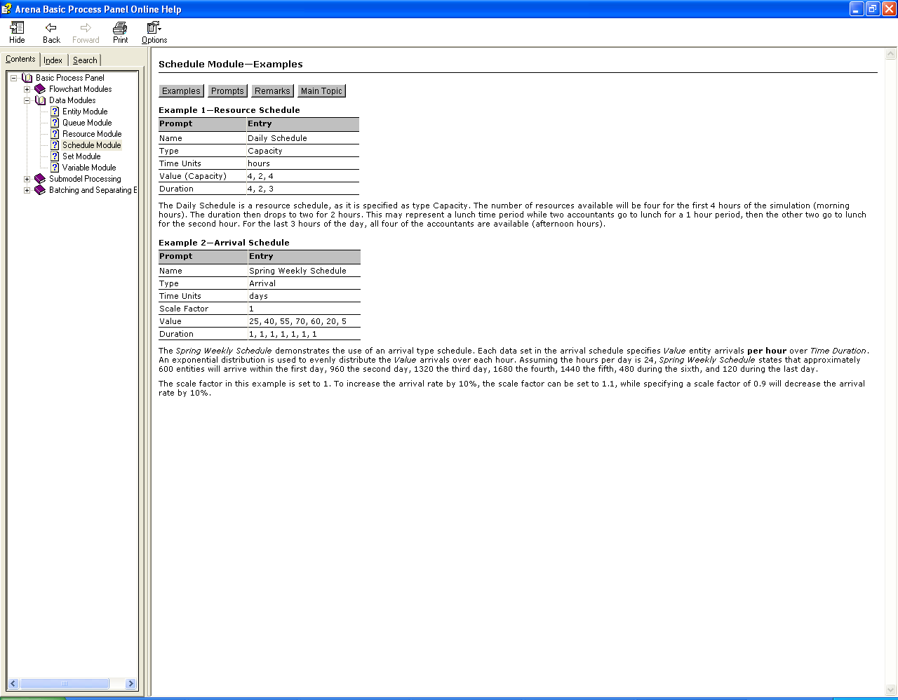
Non-stationary Arrival Processes
Arena implements a correct non-stationary Poisson arrival process.

Slide 95
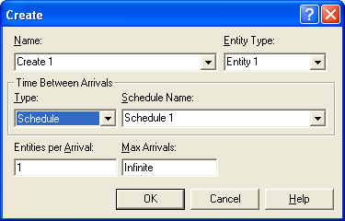
Non-stationary Arrival Processes

